Slide 1
1 Minute film competition
28th July 2017

Slide 2
THEME: Tomorrow
National competition with great prizes
Create a new film for the competition
OR
Work from something you made in class

Slide 3
Relationships of tomorrow
First love: falling for someone; breaking up – what does the future hold?
Friends and family: Who might be here? Who might be gone?

Slide 4
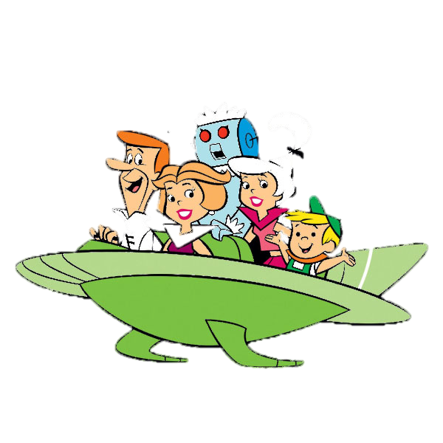
Technology of Tomorrow
Sci-fi: Robots and little green men
Technology and politics: Dystopias and utopias
Online communities: what’s next?

Slide 5
Emotions of tomorrow
Anxiety: facing fear of something
Ambition: preparing for something
Excitement: looking forward to something

Slide 6
Issues of tomorrow
Documentaries or Dystopias based on:
Environmental degradation
Disease epidemics
Despotic governments
Increasing racism
War and conflict

Slide 7
ghosts of tomorrow
Fortune telling
Ghostly encounters
Dreams and visions

Slide 8
THEME: Tomorrow
See Ms Carmyn in the library for more information
OR go to
ATOM: http://1-minutefilmcompetition.org/

